Slide 1
Power Enjoy System Software Engineering 2 Project
Niccolò Raspa
Matteo Marinelli

Slide 2
RASD: Text Assumption
How to Pay?
Unsafe Area Praking
User leave the car in an unsafe area during a reservation
Particular system behaviour since special event
Solution of the situation → User bring the car in a safe area
→ Reservation closure after 1h and request of assistance

Slide 3
RASD: Domain Assumptions
4 main clusters:
External Services
Legal Policy
Domain Assumptions
Communication
Correctness and Availability

Slide 4
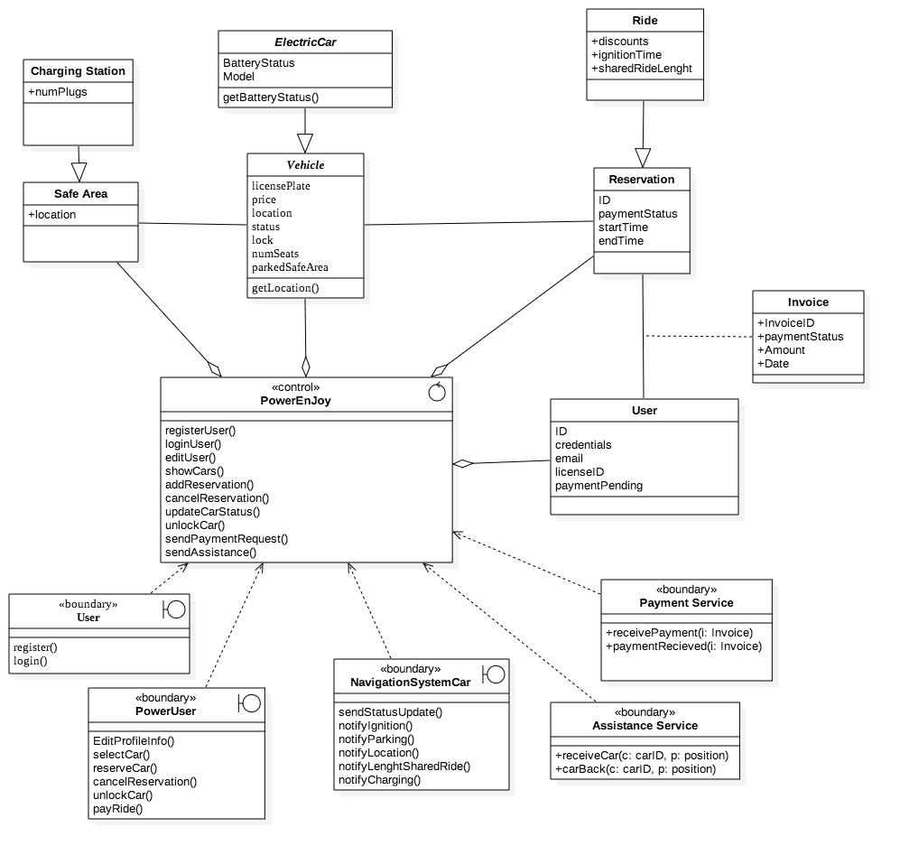
RASD: Class Diagram

Slide 5
From RASD to Design Document
Database
Application
External Serv.
Client

Slide 6
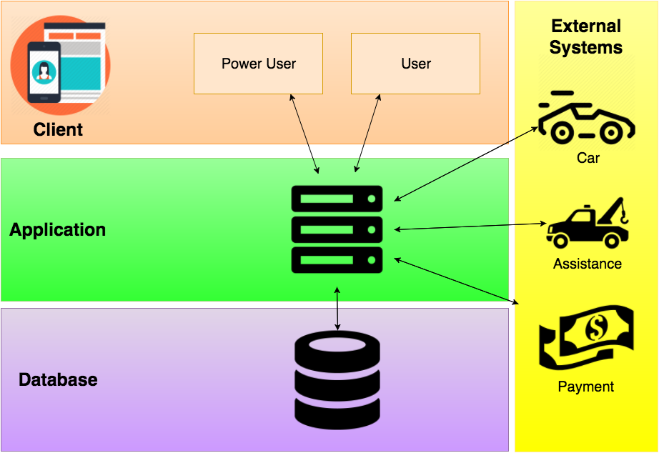
DD: High Level Components
Three tiers architecture

Slide 7
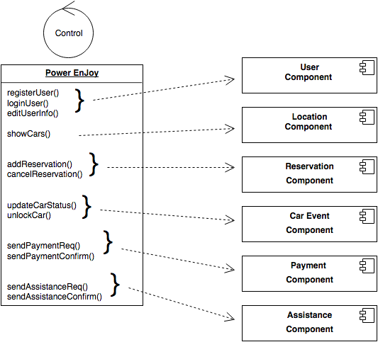



DD: Application Layer
Timer Component added according to implementation needs

Slide 8
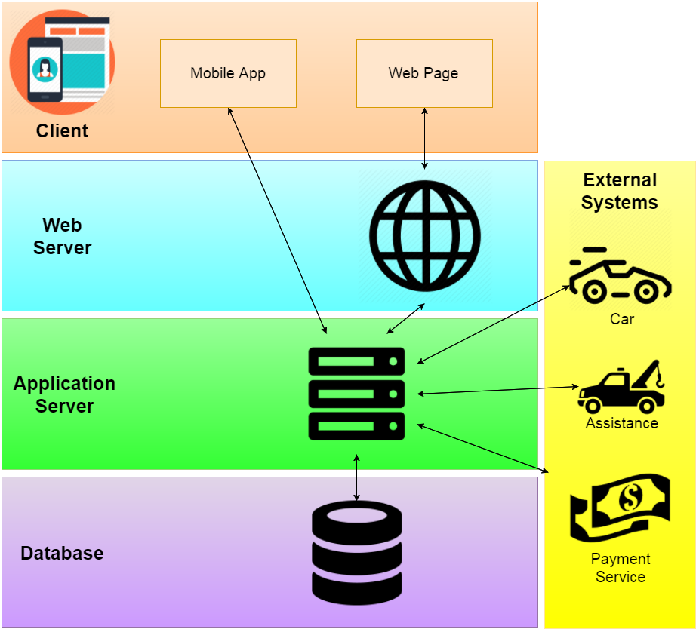
DD: From 3 to 4 Tiers
Add a component inside the Client Layer
Imroove efficiency with an oriented optimization
Mobile App VS Web Page
Required Web Server Layer

Slide 9
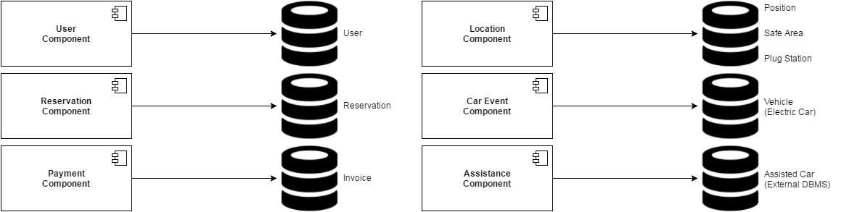
DD: Service Oriented Architecture
Problems
Application Server is the bottleneck of our system
The performance of this layer is strictly related to the overall performance of the system
SOLUTION
Split the workload among different services
Simple and clear Interface to other components
Each component is responsible for some entities in the database
Benefits
Clean Architecture
Modularity
Ease Improvement

Slide 10
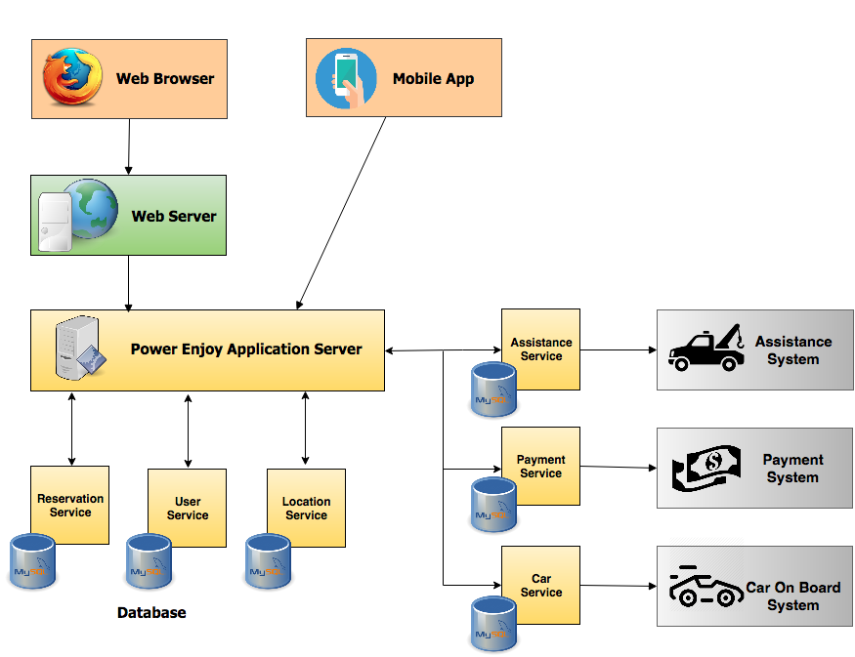
DD: Final Architecture

Slide 11
Integration Testing

Slide 12
ITPD: Integration Testing Strategy
Assure that services in relations with external systems works as expected
Assure that we have control over the Car
Integration of Services
Integration with top layer

Slide 13
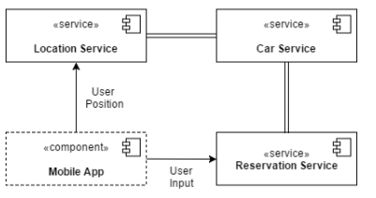
ITPD: Reservation Integration Testing

Slide 14
ITPD: Technologies and Testing Tools
Manual Testing
JUnit
Mockito
Arquillian
Devices
Power Enjoy Cars
Drivers and Stubs

Slide 15
Project Plan
Document supposed to be at the beginning of the project
Early Design choice mandatory for the calculation of the effort (COCOMO)
Drivers Scale and Function Points values based on our real skills and experience
SLOCavg=7728 → Effort= 31,47 PM → Duration≈16 months for 2 developers
High duration since Early Design choice but reasonable

Slide 16
PP: Risks

